Slide 1
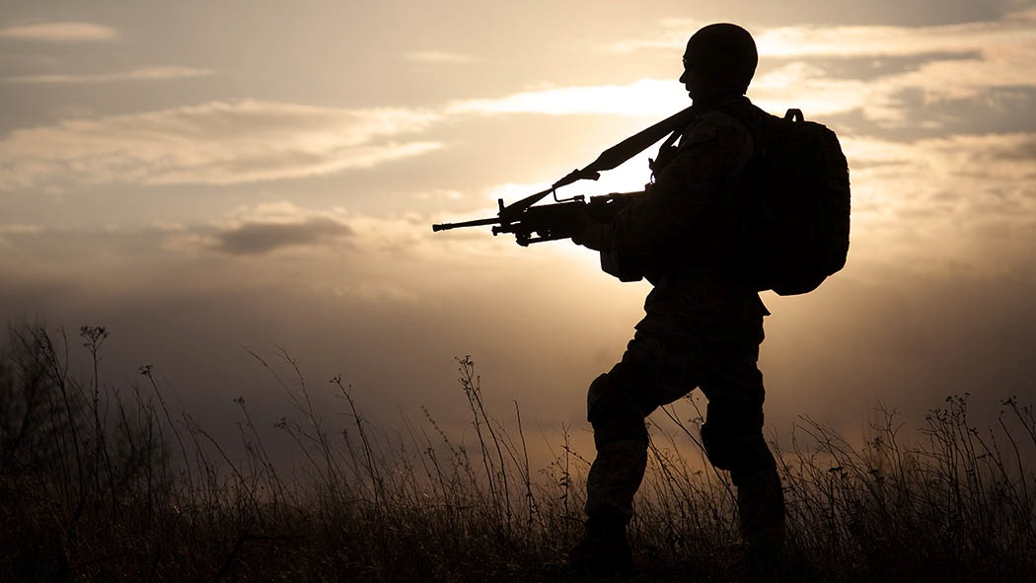
My Army
My life
16121349 范敏

Slide 2
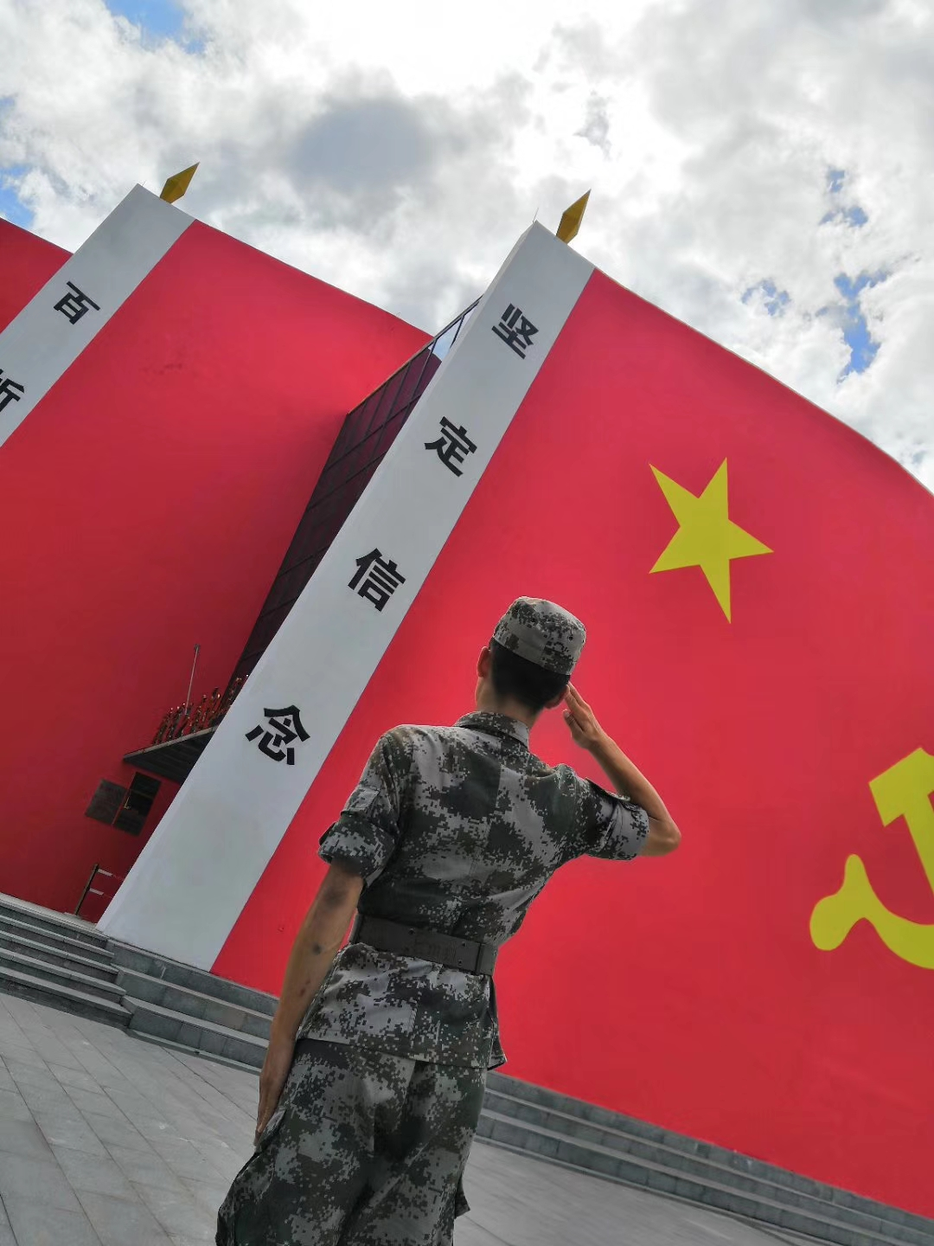
01
My experience
02
CONTENTS
Things about army
03
Feeling of army

Slide 3

2018.08.15
three months training as a
new recruit in NanJing
Change my position to messager because of wrist fracture
2017.12.25
2017.09.17
Serve an intelligence force
as a scout in FuZhou
Join the army from SHU

Slide 4
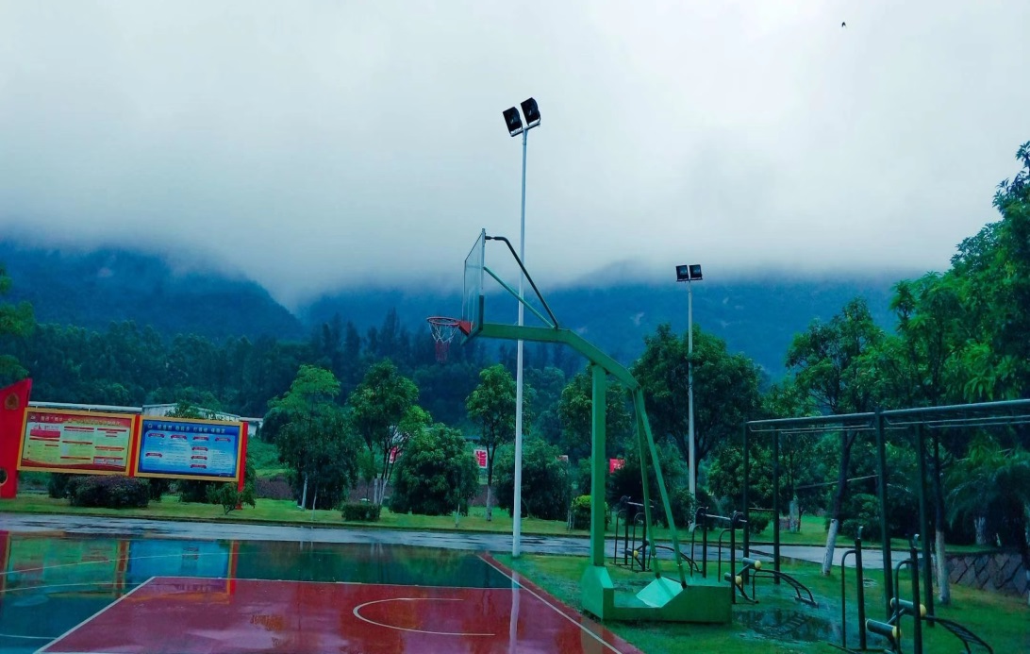
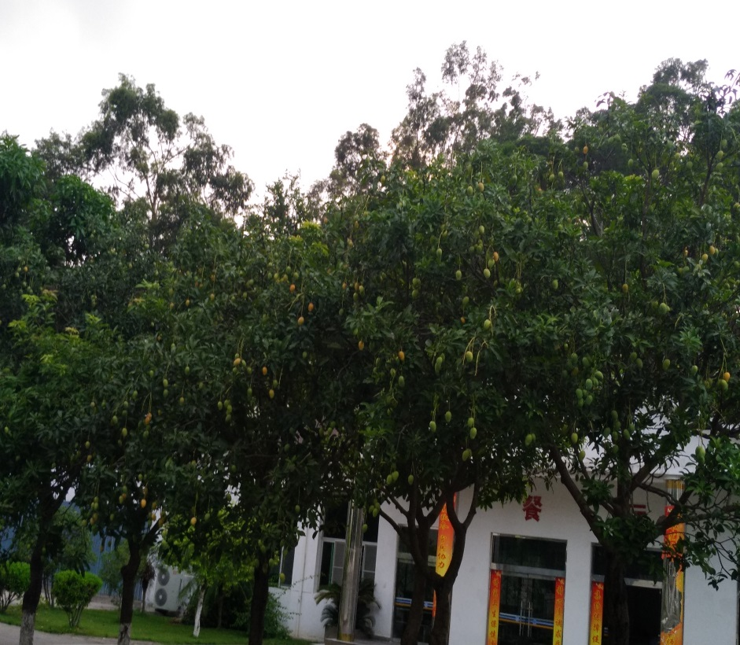
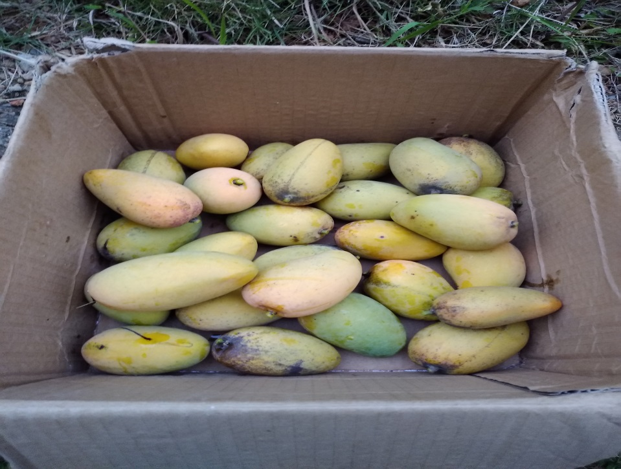
Our military camp

Slide 5
Daily routnie
6:00 | Get up
6:00-6:40 | Moring run
7:10 | breakfast
8:00-11:30 | Subject trainning
12:00 | Lunch
12:50-14:00 | Noon break
14:30-16:30 | Subject trainning
16:50-17:50 | Physical trainning
18:30 | Dinner
19:00 | CCTV News
19:30-22:00 | Night trainning
22:30 | Sleep

Slide 6
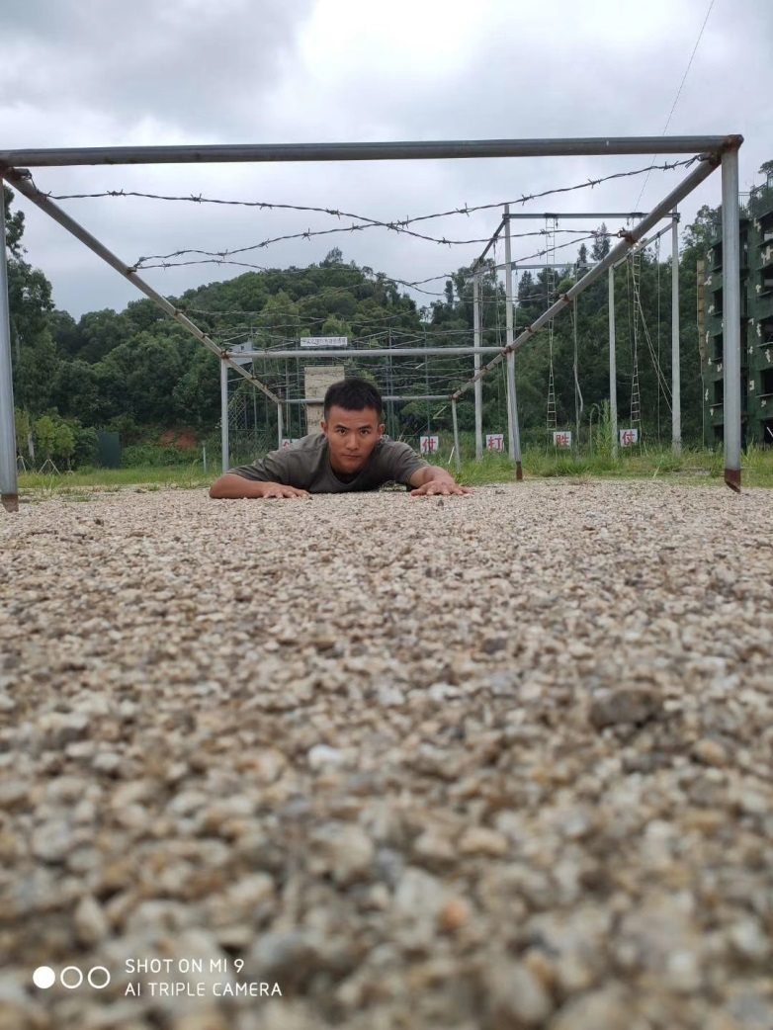
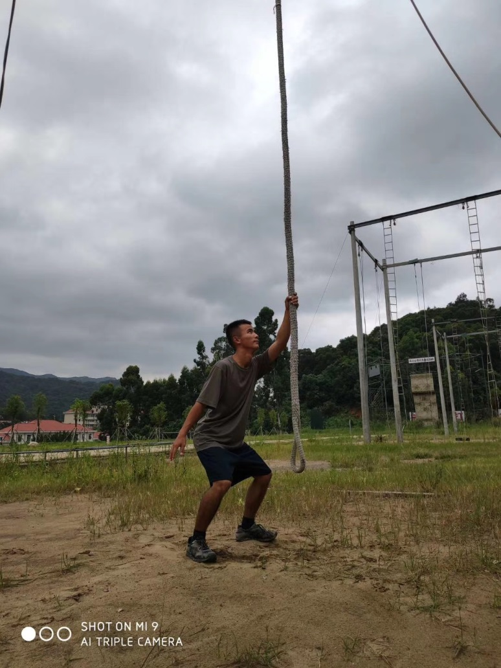
Crawl forward
climbing

Slide 7
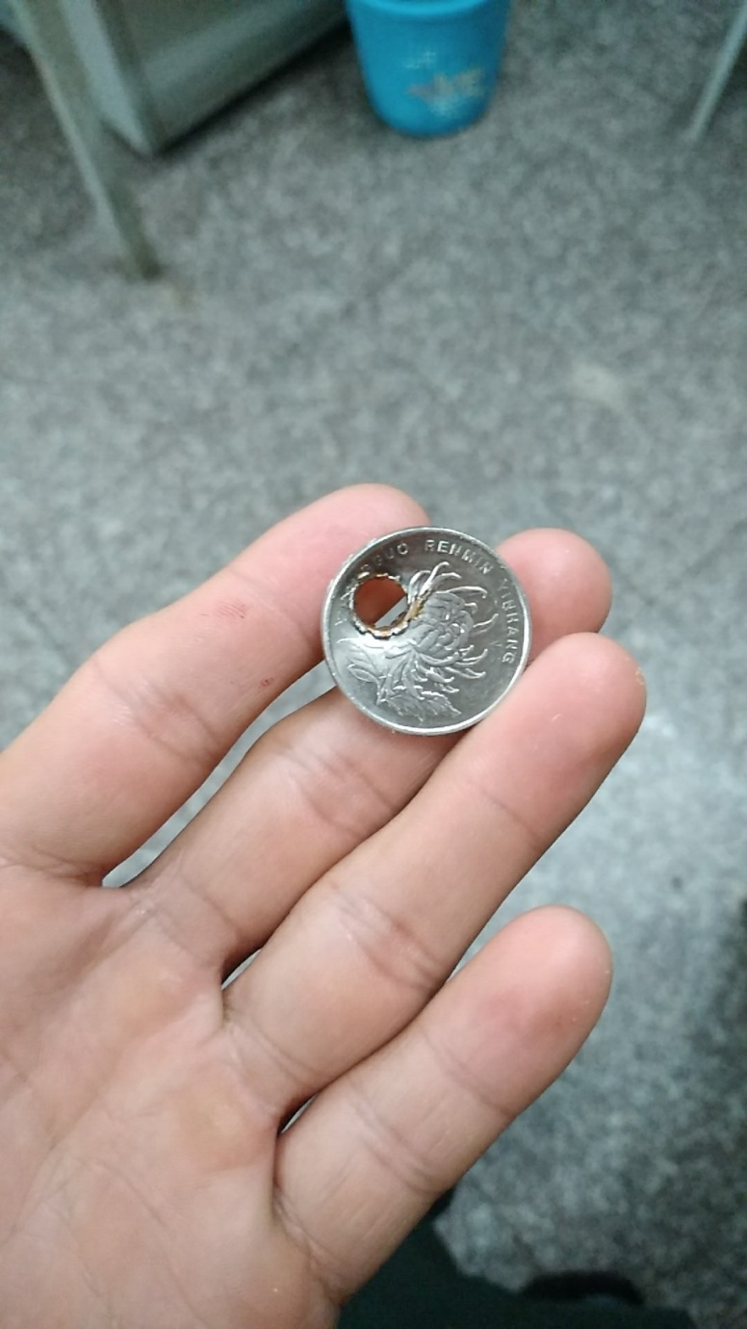
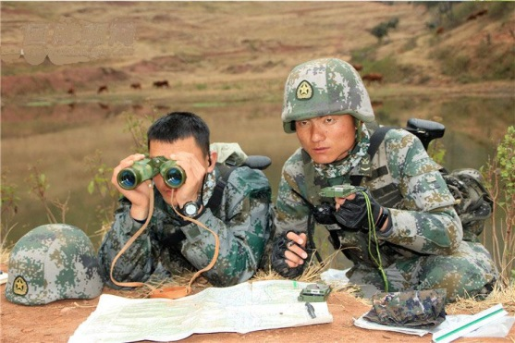
Military topography
Gun Shooting

Slide 8
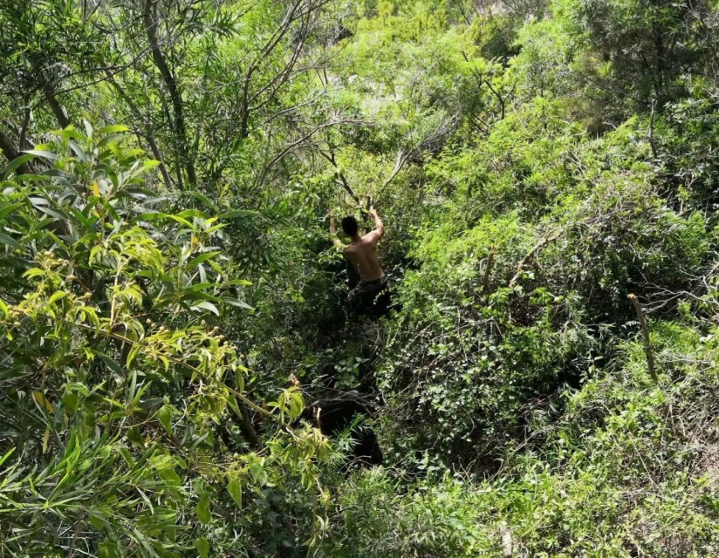
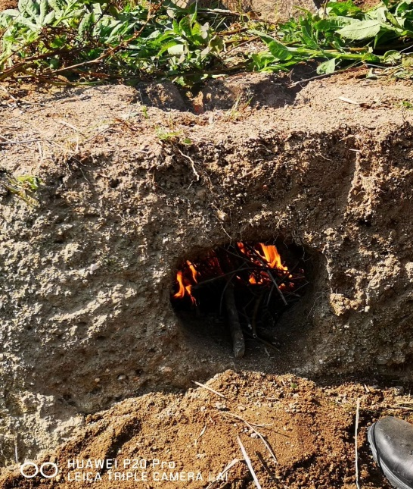
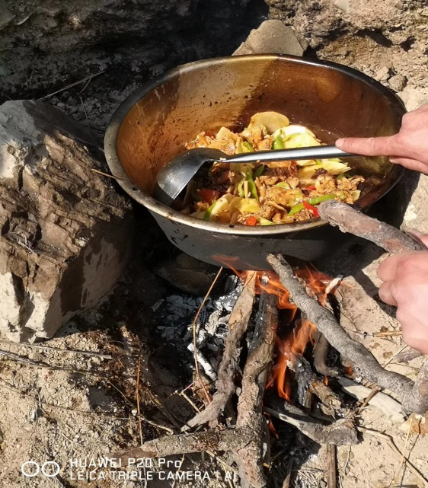
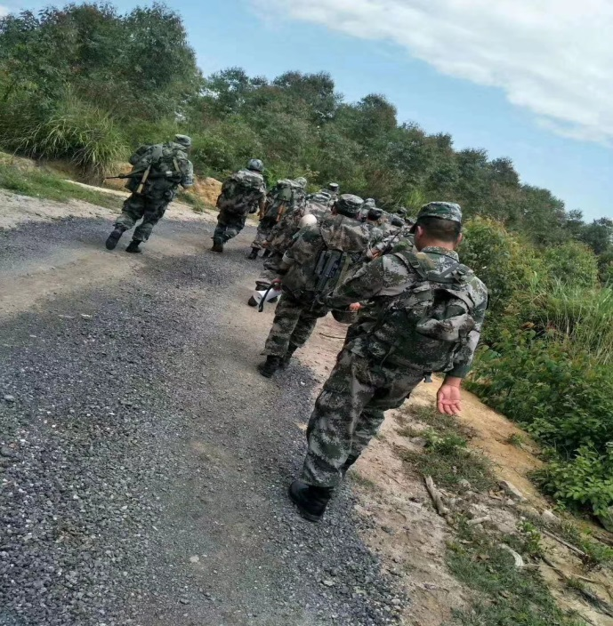
Route march

Slide 9
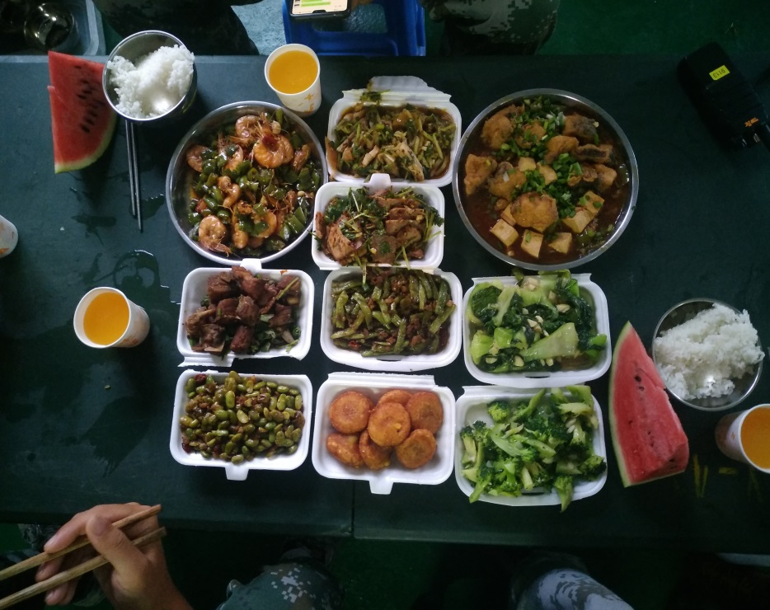
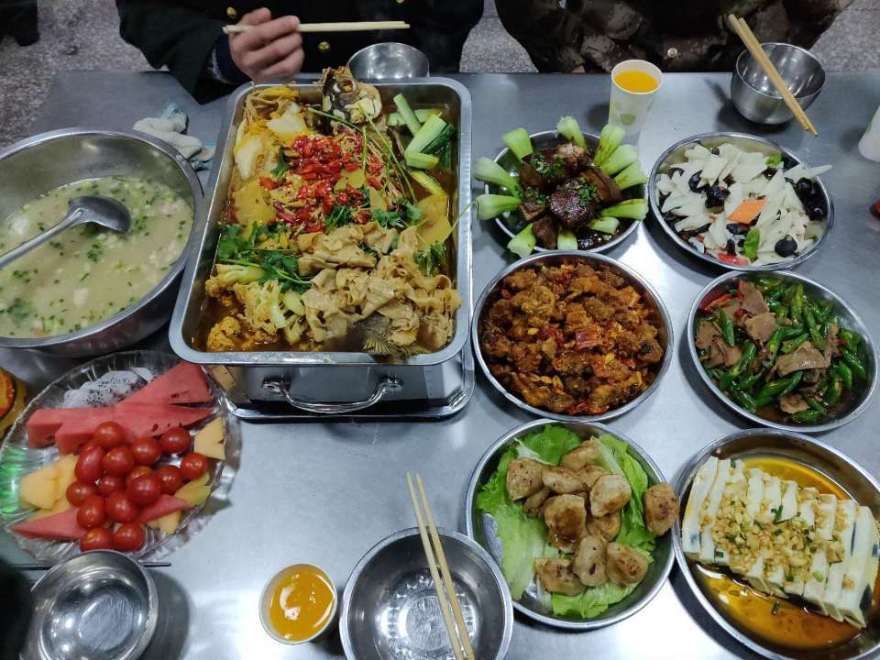
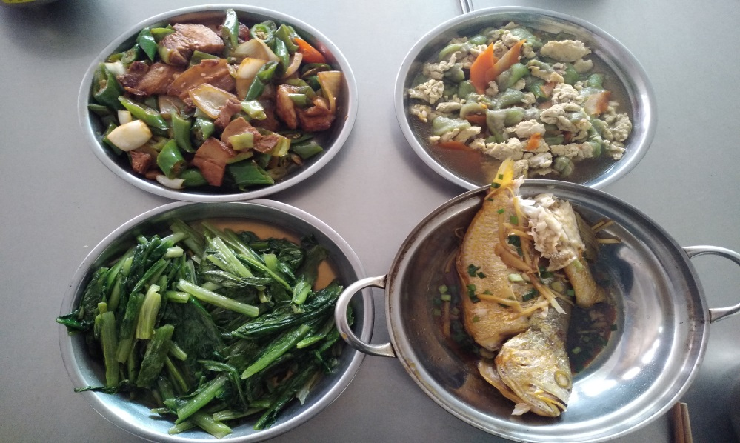
Festival meal

Slide 10
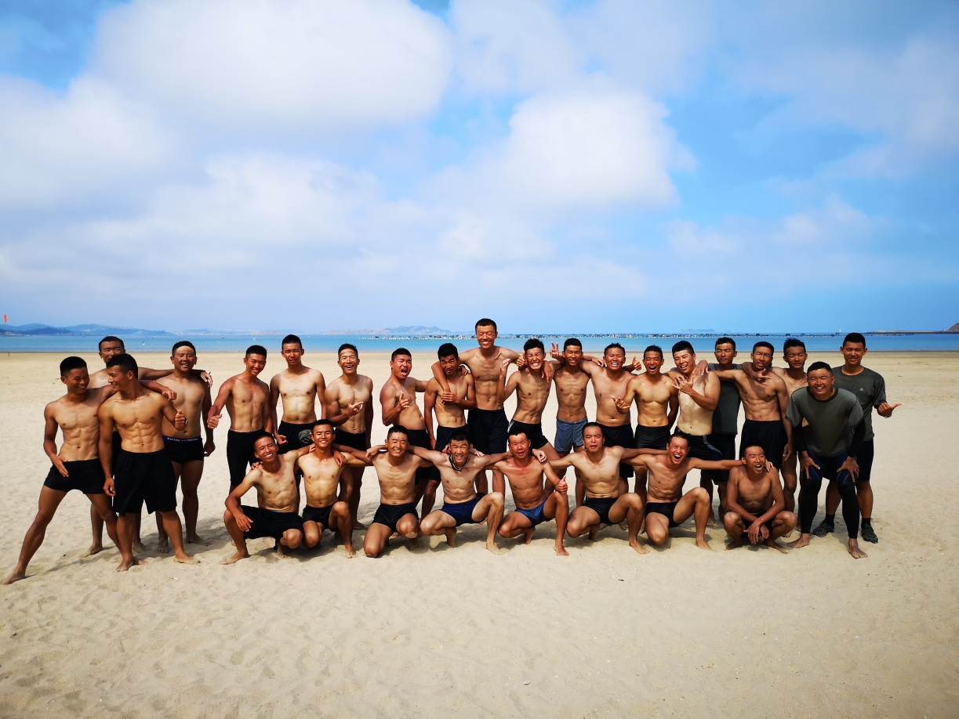
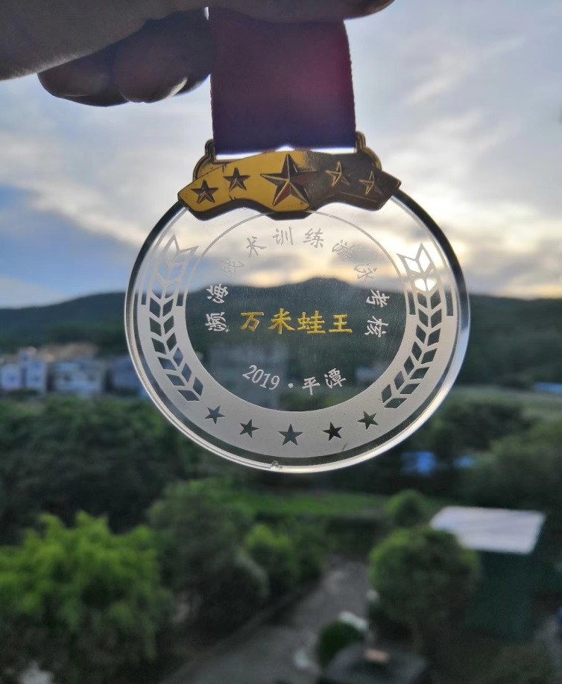
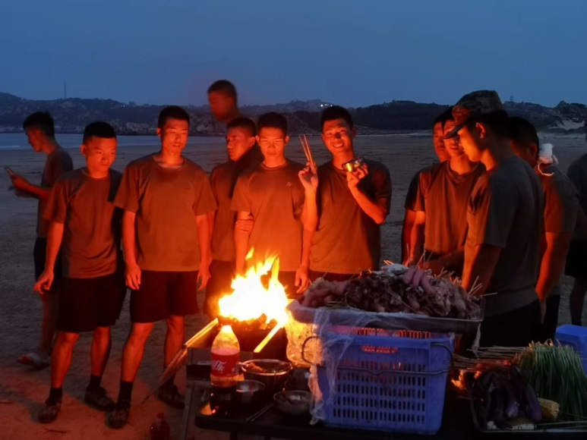
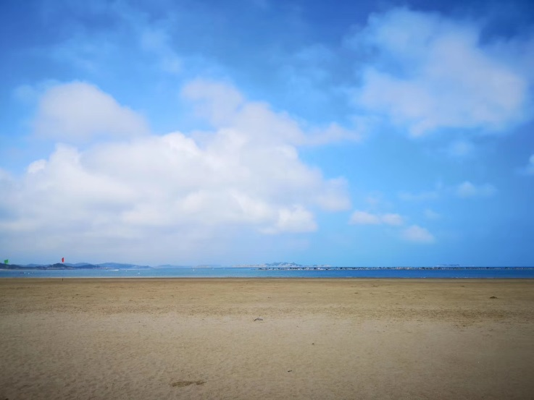
Sea Swimming
PingTan Island

Slide 11
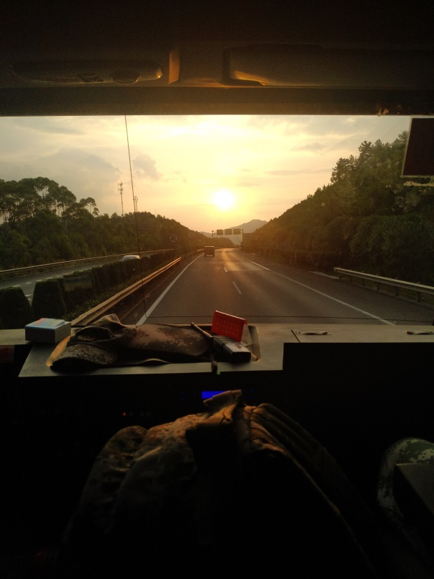
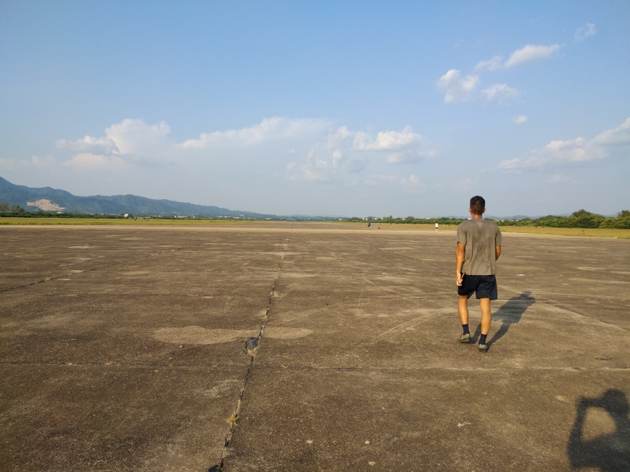
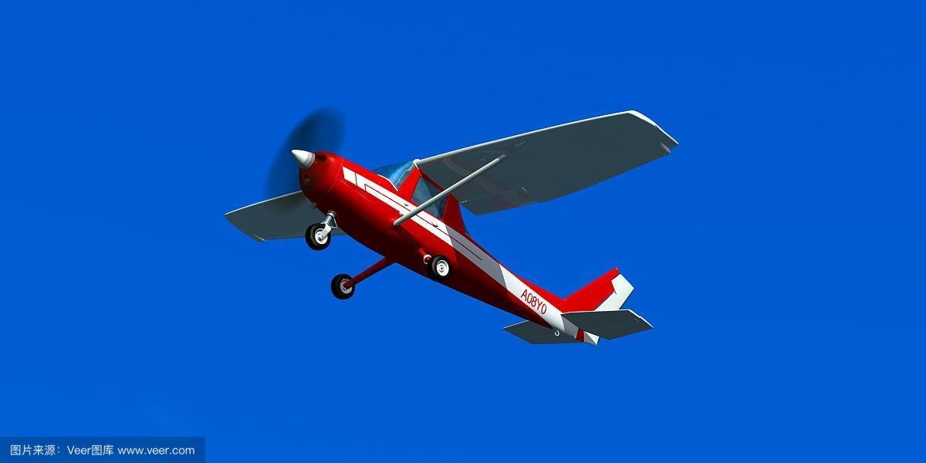
Drone’s flight control
Length:5.98m
Width :10m
Height:2.34m

Slide 12
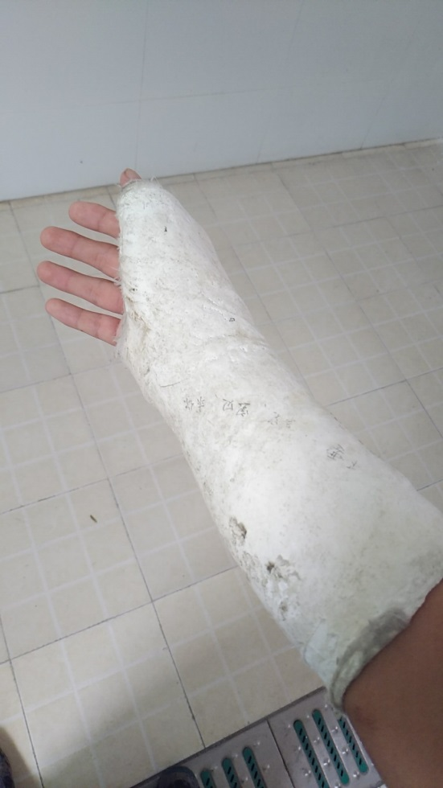
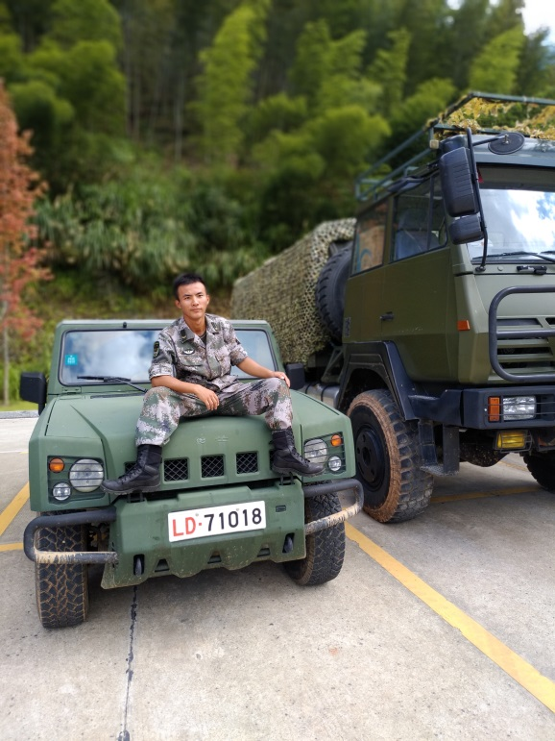
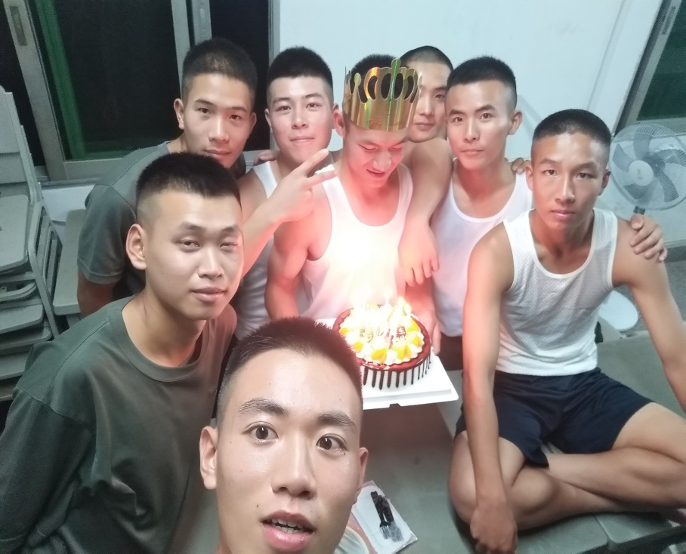
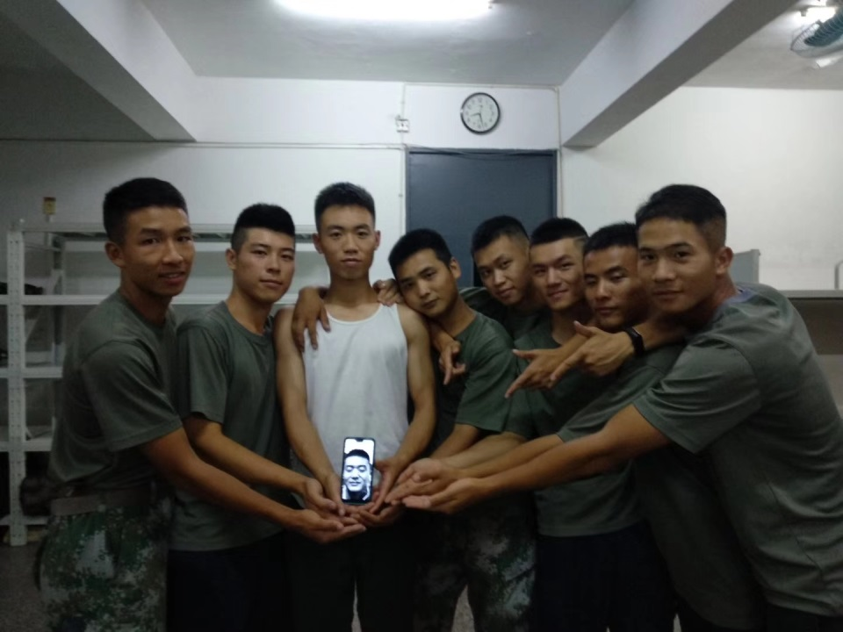
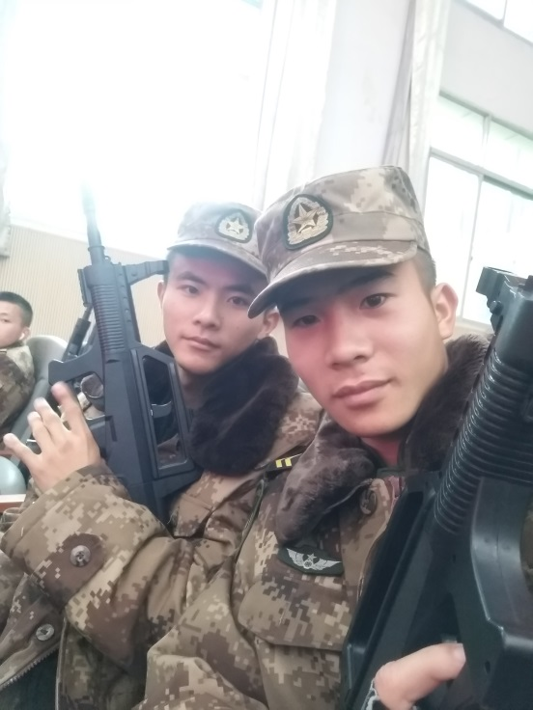
photos of mine
and
my brothers

Slide 13
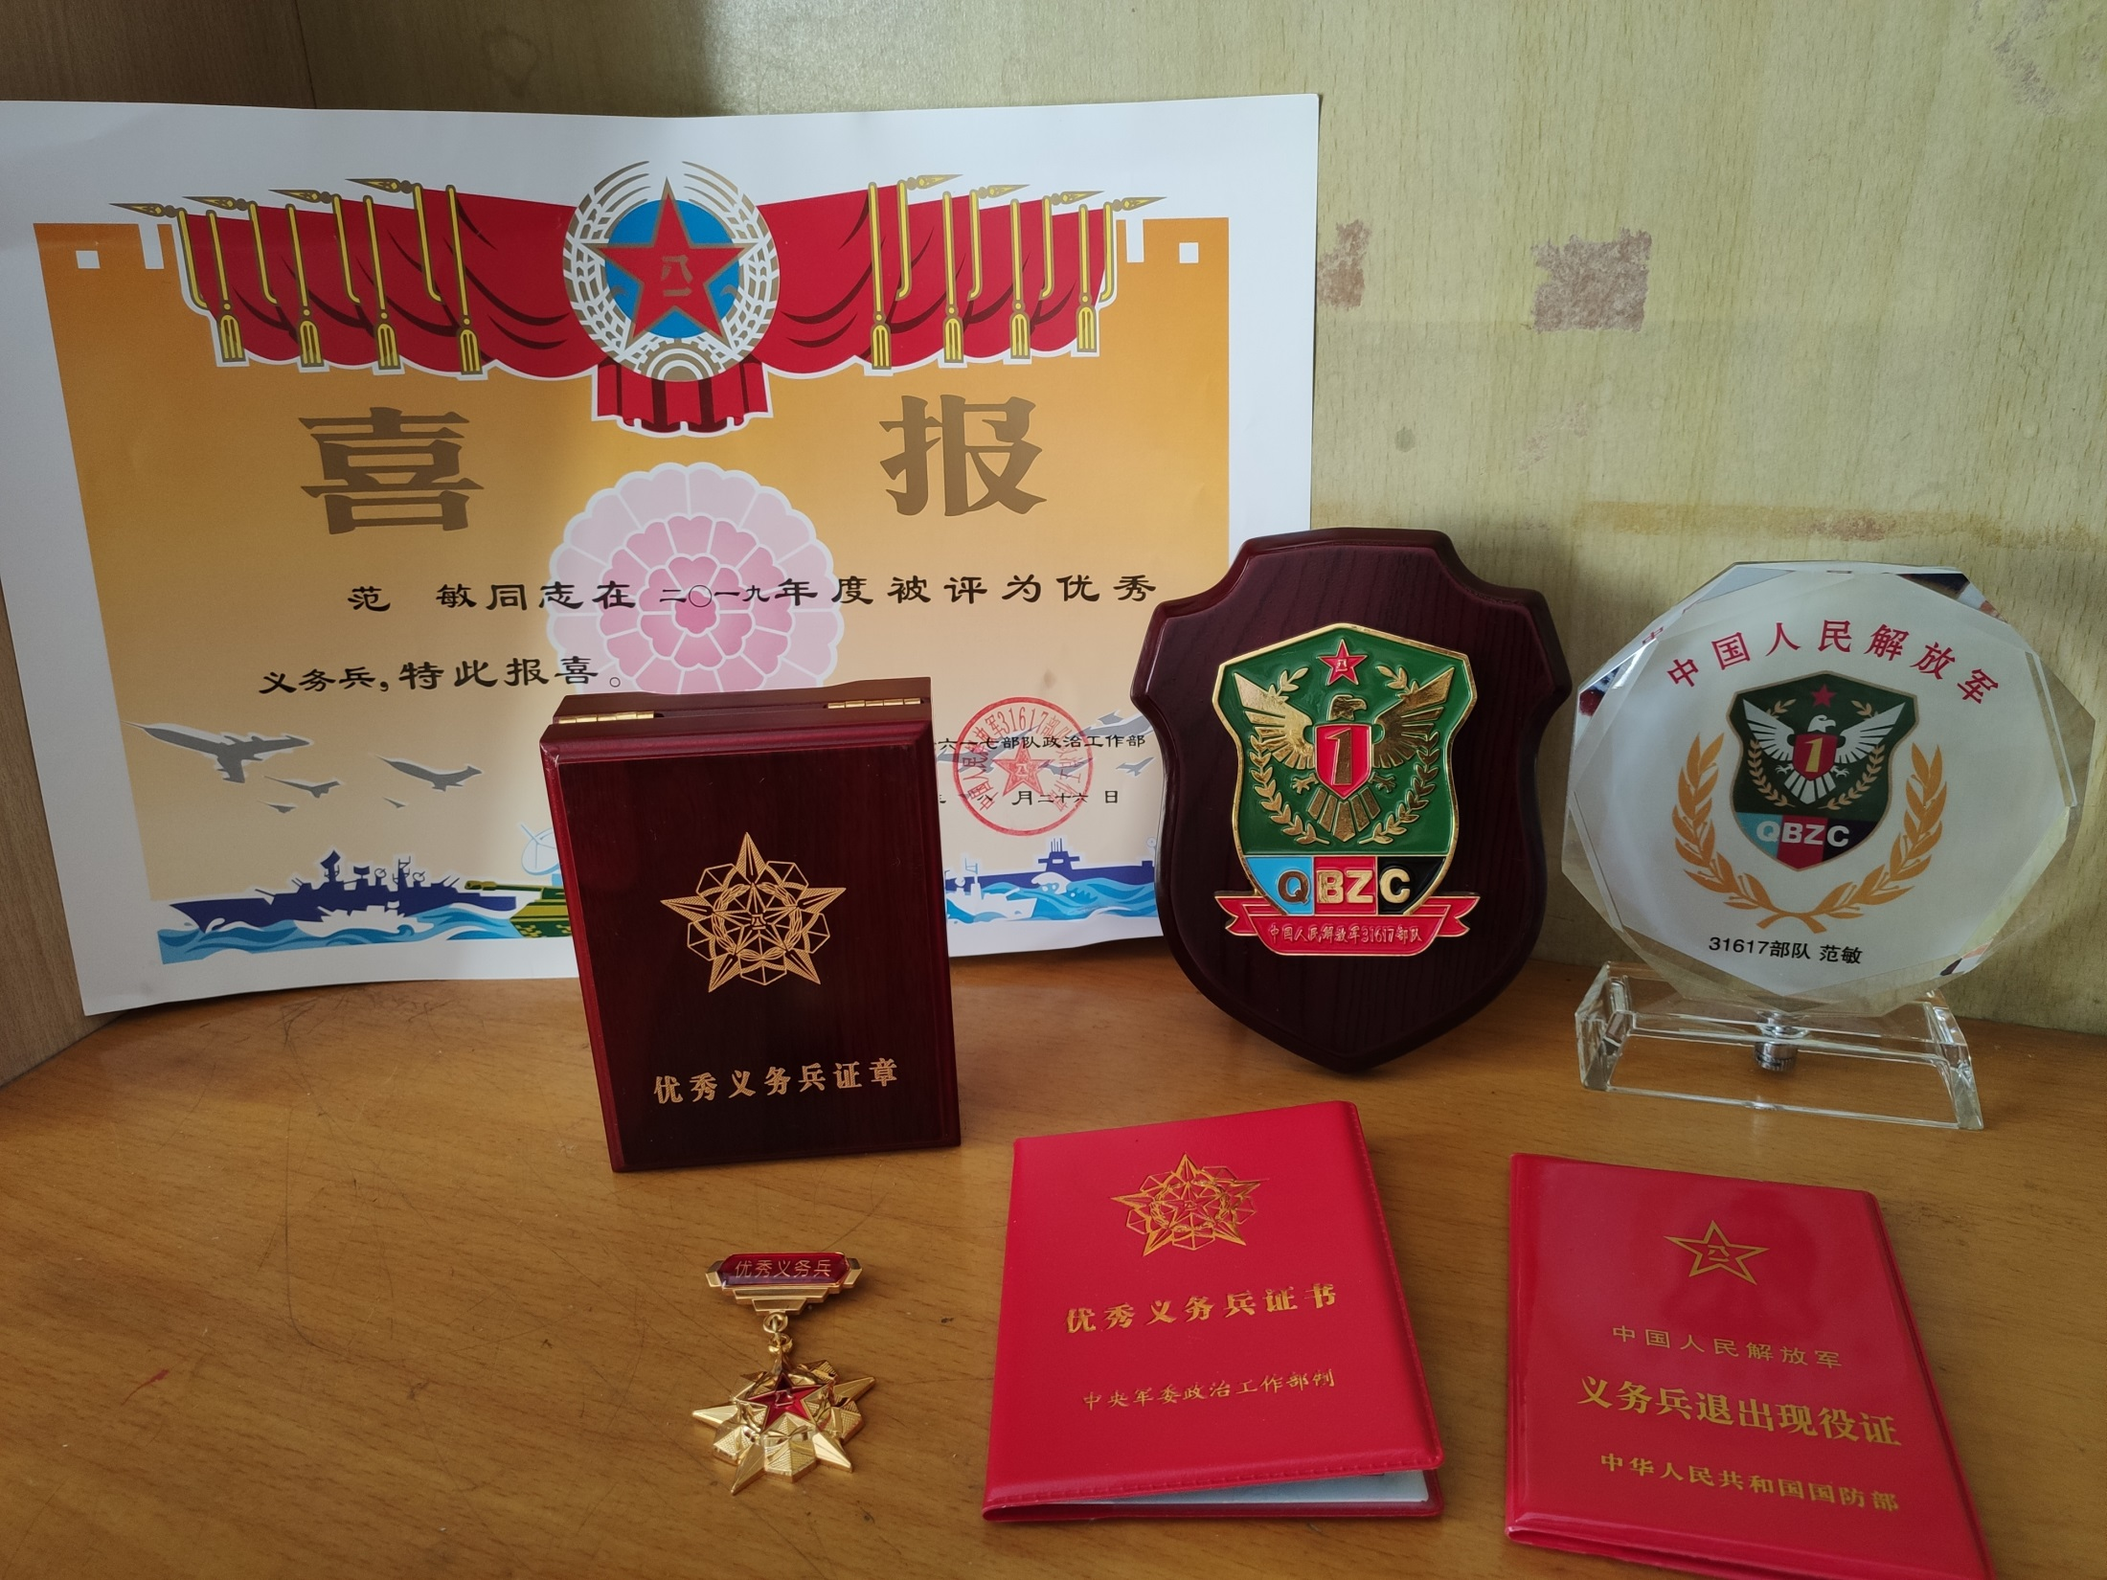

Slide 14
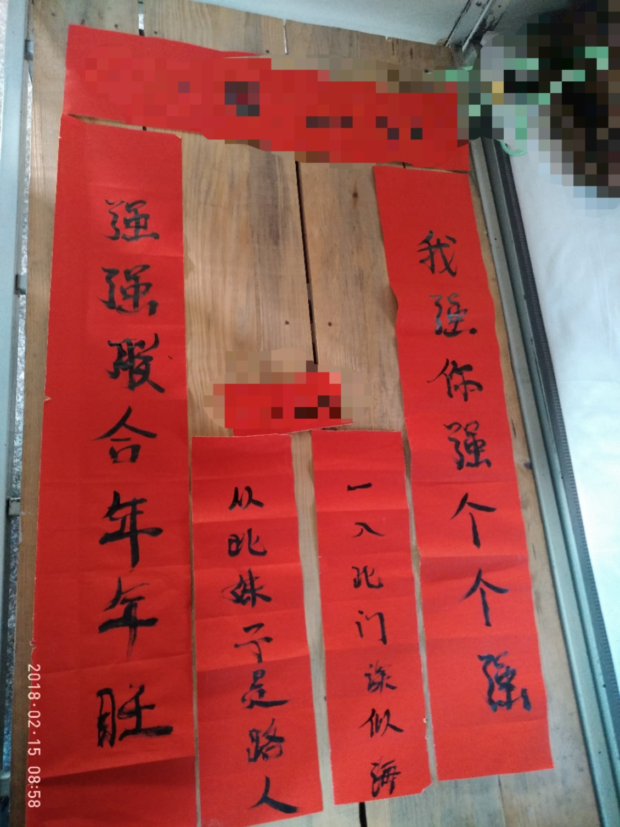
Feelings of army
1.Make your body strong
2.Colorful and boring
3.Conduct yourself
4.Reap frinedship

Slide 15
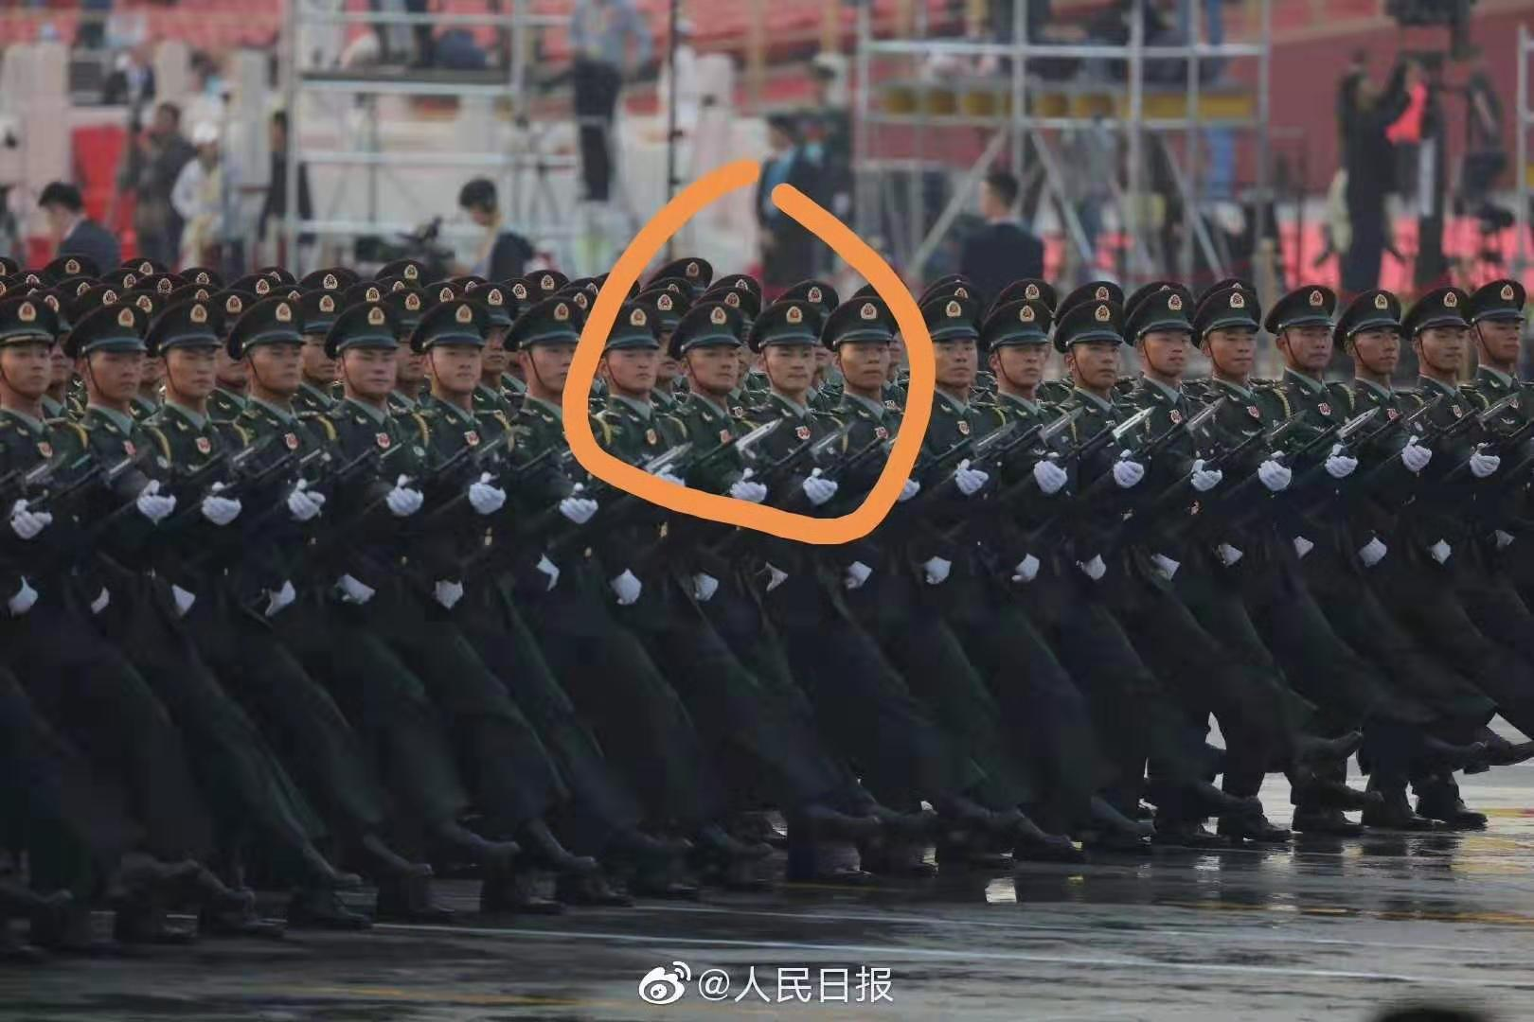
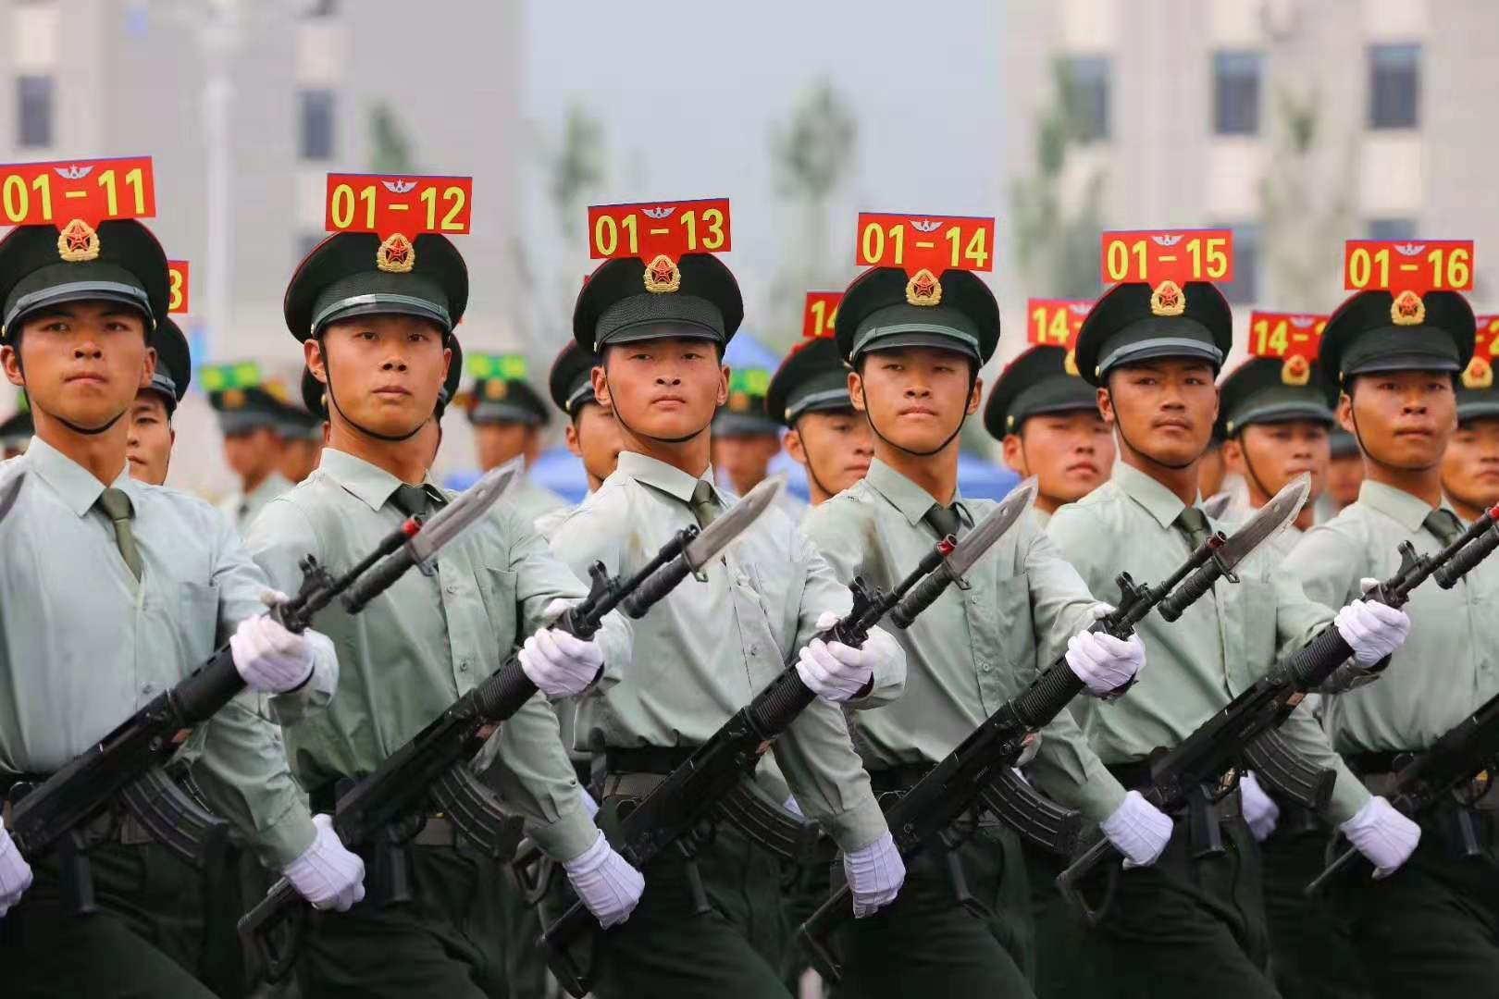
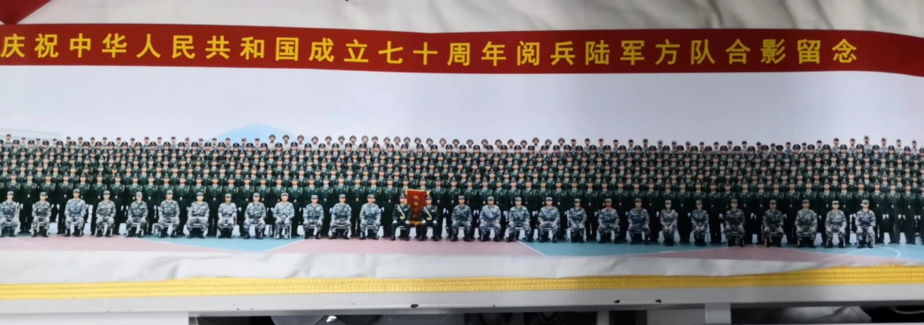
70th Anniversary Parade

Slide 16
Thanks for
your listening

